Slide 1
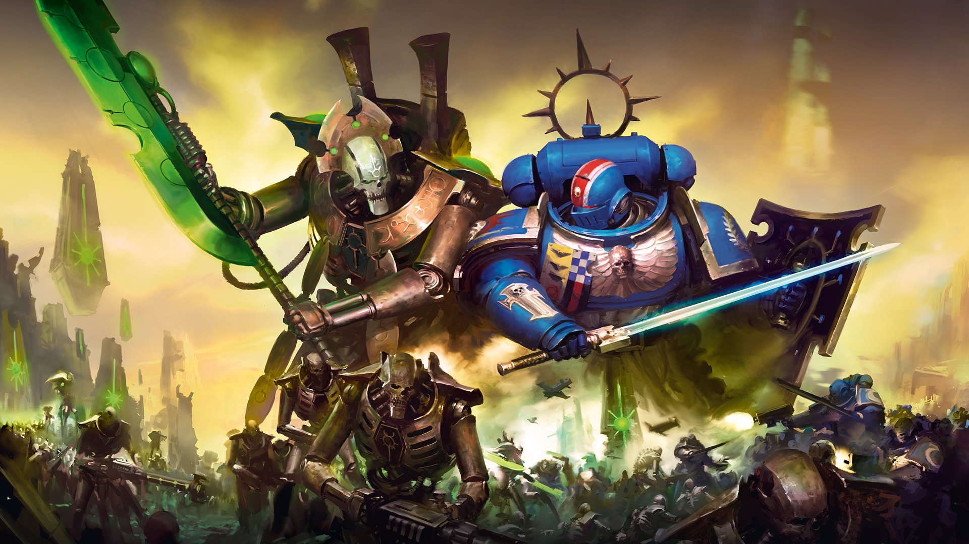
Warhammer 40'000
In the grim darkness of the far future
There is only WAR

Slide 2
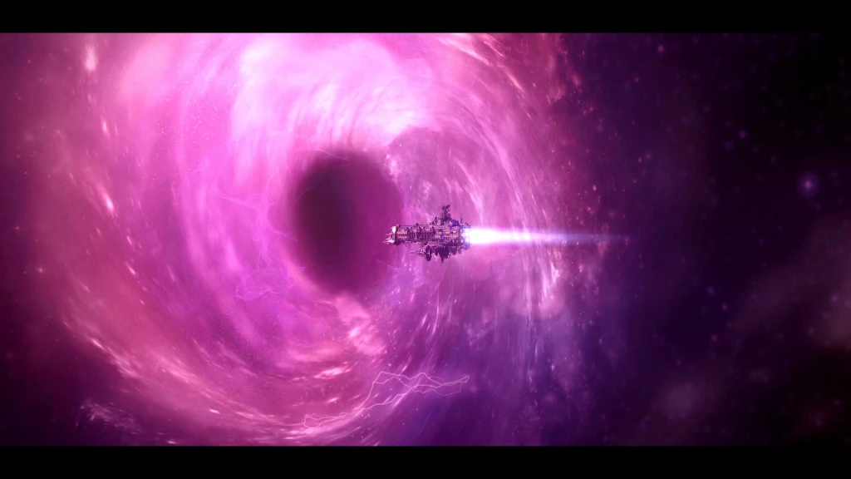
Why Machine Learning ?
A logical journey

Slide 3
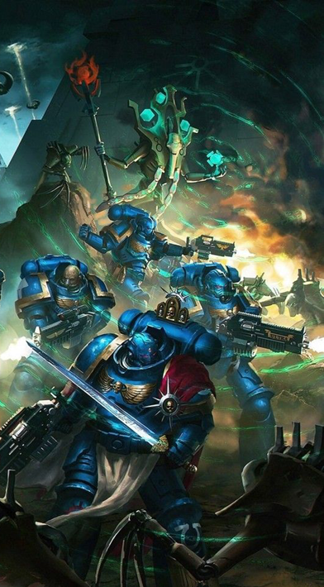
What is Warhammer 40'000 ?
1 – Turn-base Tabletop Game
- Played around a table
- Each player play alternatively
2 - Dark science-fantasy
- Set in the 41th millenium
- Every faction is evil...
- Or too stupid for that
3 – Next MCU
- The game / universe is more and more popular

Slide 4
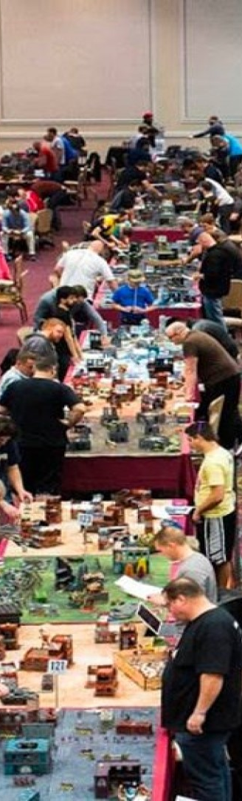
How is it played ?
1 – Army preparation
- Choose one of the 20+ factions
- Write down an army list within the agreed limit
- Collect and paint your models
2 – Meet your friend
- Reunite around a table
- Prepare the table setup
- Choose deployment and mission
3 – Play !
- Destroy your friend's army is not enough (but still satisfying)
- You must score more tactical objective points

Slide 5
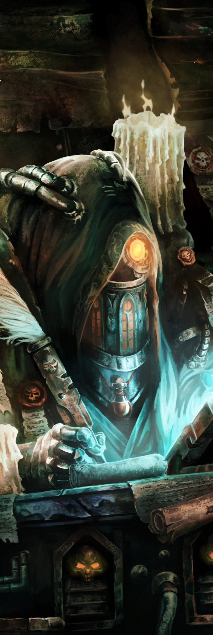
Game's Structure
Turn 1
Turn 2
=== Player 1 ===
--- Movement Phase---
Unit 1 moves
Unit 2 moves
↓
--- Shooting phase ---
Unit 1 shoots
Unit 2 shoots
=== Player 1 ===
--- Movement Phase---
Unit 2 moves
Unit 1 moves
↓
--- Shooting phase ---
Unit 2 shoots
Unit 1 shoots
...
=== Player 2 ===
--- Movement Phase---
Unit 3 moves
Unit 4 moves
↓
--- Shooting phase ---
Unit 3 shoots
Unit 4 shoots
=== Player 2 ===
--- Movement Phase---
Unit 4 moves
Unit 3 moves
↓
--- Shooting phase ---
Unit 4 shoots
Unit 3 shoots

Slide 6
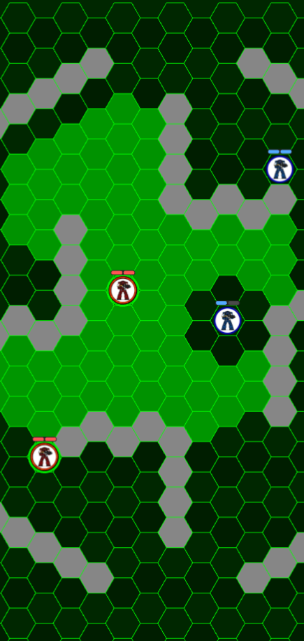

Movement Phase
Units can :
- Move up to M hexes
Units cannot :
- Move to or through a wall
- Move to another unit's hex
- Move to an hex adjacent to an enemy unit

Slide 7
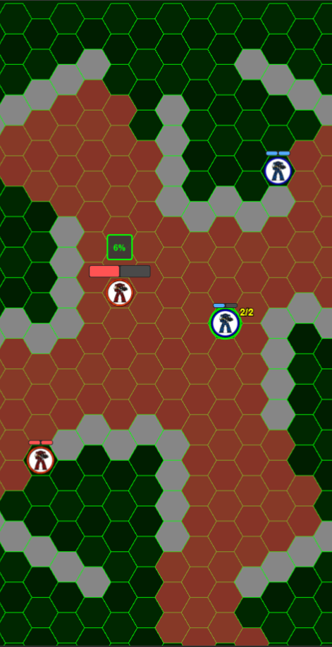
Shooting Phase
Units can shoot :
- Up to their A times
- At units in Line of Sight
- At units within their RNG
Shooting Sequence :
Hit Roll : must roll >= BS
Wound Roll : Weapon's S vs Target's T
Armor Save (SV) – AP
Inflict D damages

Slide 8
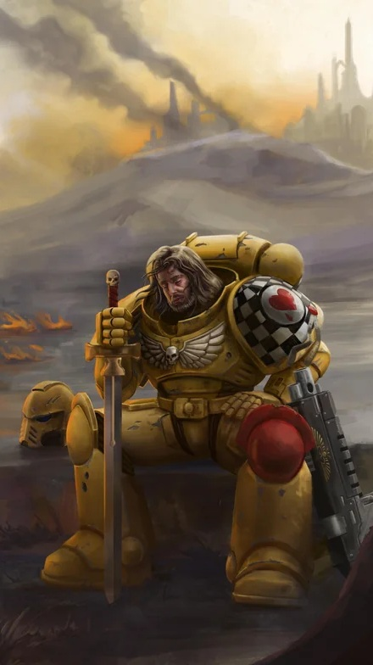

The wargamer's doom
To play a 2 players game ...
You need to be TWO !

Slide 9
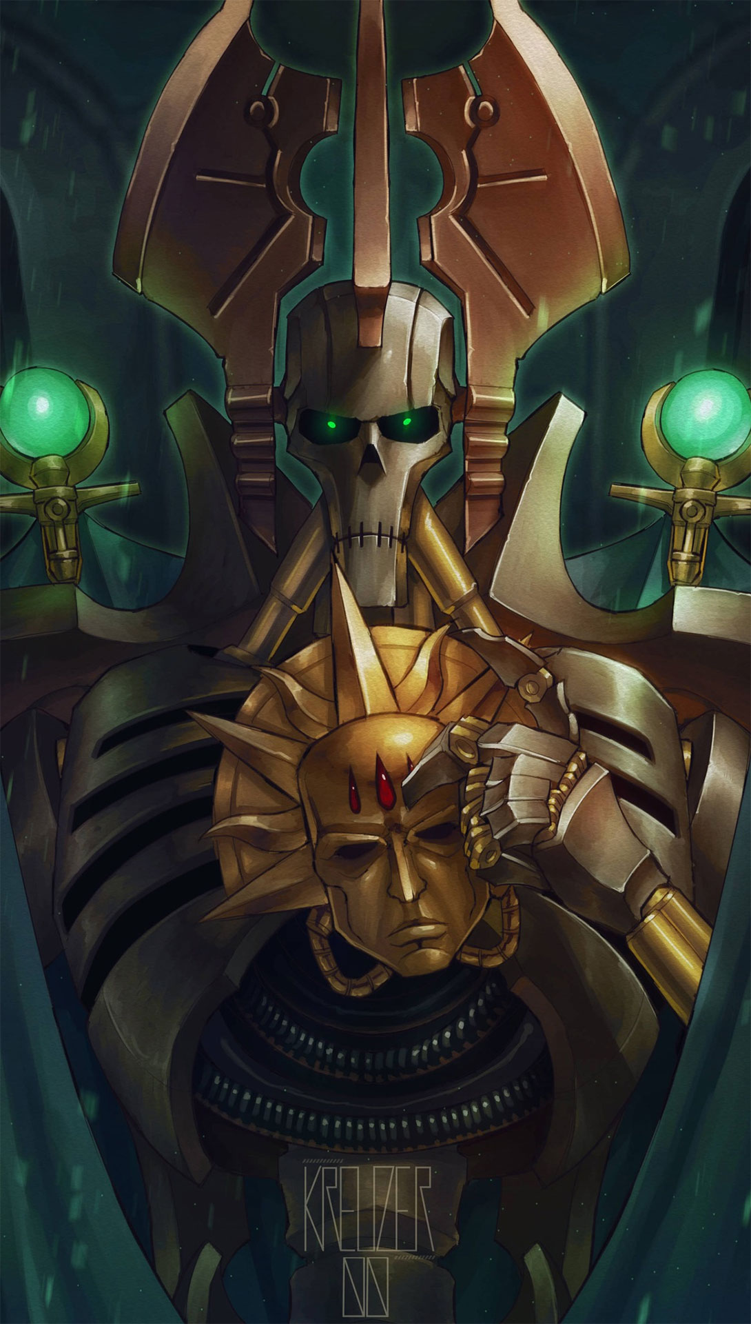
You have a new friend !
No more need of an unfaithful human to play !
Welcome the Reinforcement Learning AI !!
A friend for life

Slide 10

Technical solution
Make it real
Frontend : React
Game Requierments :
- Board Management:
- Real-time UI Updates without full re-renders
- Event Handling: Click events
Performances :
- PIXI.js Integration:
- React manages PIXI.js canvas
- TypeScript Compatibility

Slide 11

Technical solution
Make it real
Backend : Python
Obvious Choice :
- Only viable option for serious deep reinforcement learning with DQN
Familiarity :
- I have made almost all the ML training on Python

Slide 12

Technical solution
The drama
Architecture conflict !
After 3 months of work, I had achieved :
- Complete PvP mode
- Fully functional agent training
Time to play versus the AI !?
I quickly realized a major flaw in my architecture :
- The PvP was led by React (click reactive)
- The AI was led by Python, obviously
They could NOT work together !!!

Slide 13
Technical solution
Mind your own Business
Architecture Alignment
Backend drives :
- Sequential activation
- Phase transitions
- Game state authority
- AI decision making
- Action validation
Frontend displays :
- Visual representation
- User input
- Animation/UX
Clear Boundary :
Backend drives ALL game logic → Frontend focuses on the display

Slide 14
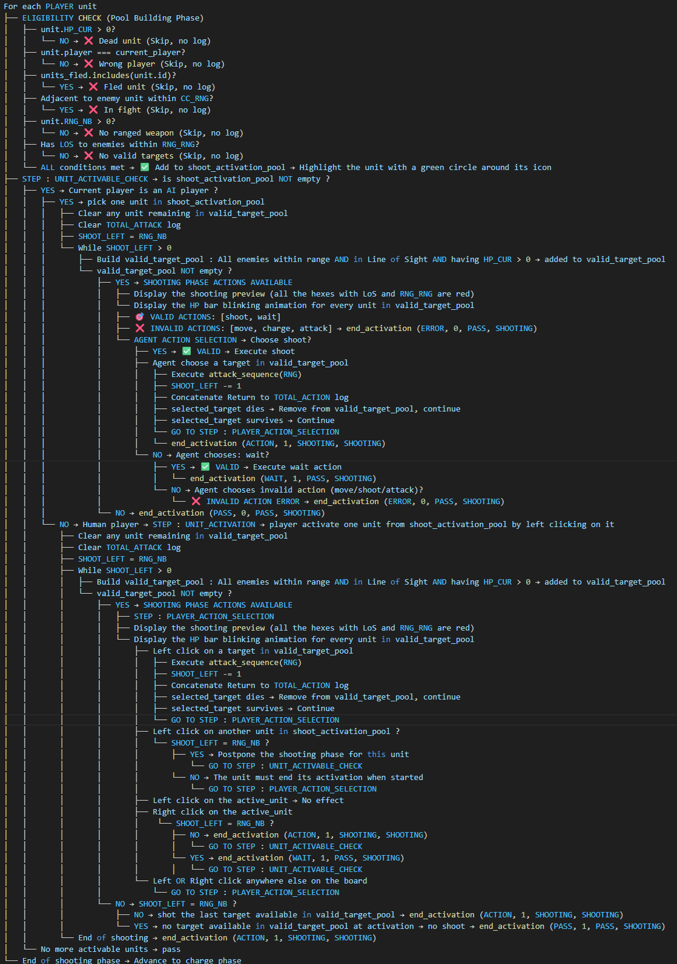
Preparation Work
Make the game follow ONE ruler
This « algorythm » describes the way the shooting phase should be played

Slide 15
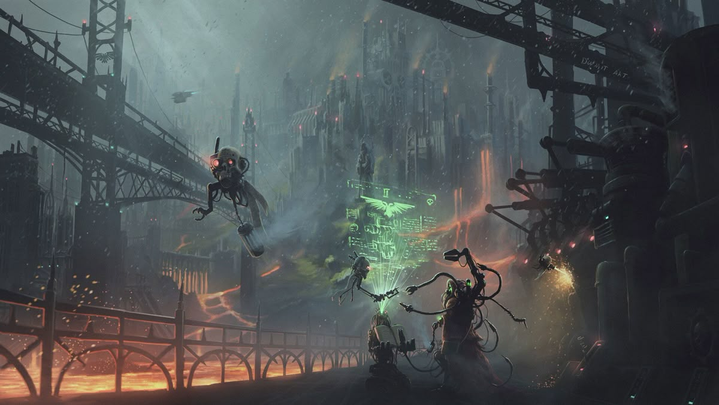
Back to the AI

Slide 16
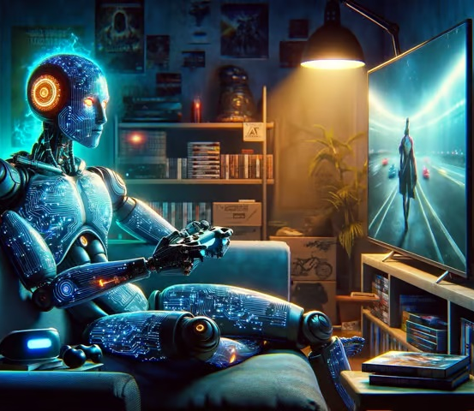
What is Q learning ?
Overview
You are playing a new video game… like a kid!
Over time, you learn what works and what doesn’t
This is the way Q-Learning works

Slide 17
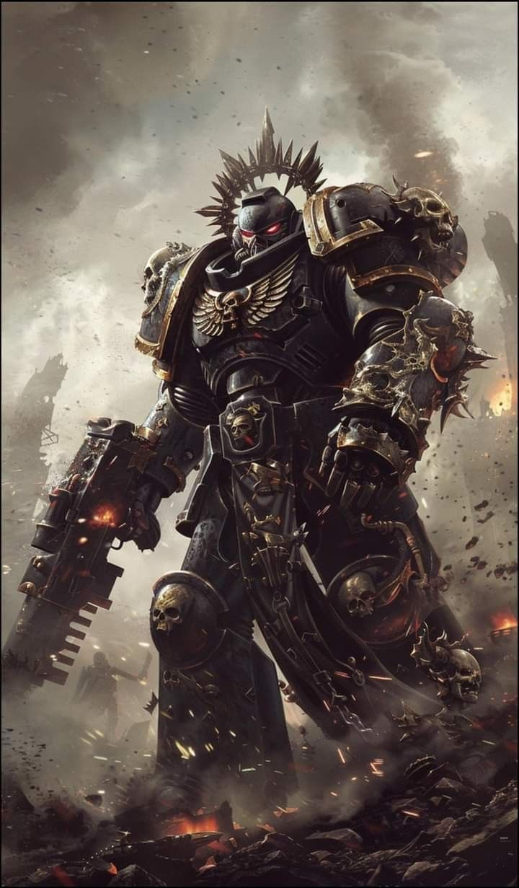
How to help Bob to survive ?
Q learning to the rescue !
Bob’s plan to survive :
1 - Bob explores his environment
→ "What if I charge a Bloodthirster or rush an objective ?"
2 – Bob builds a strategy
→ "A Bloodthirster is too dangerous, go for the objective"
Over time, Bob remembers what works best and makes better choices !
(think Edge of tomorrow)

Slide 18
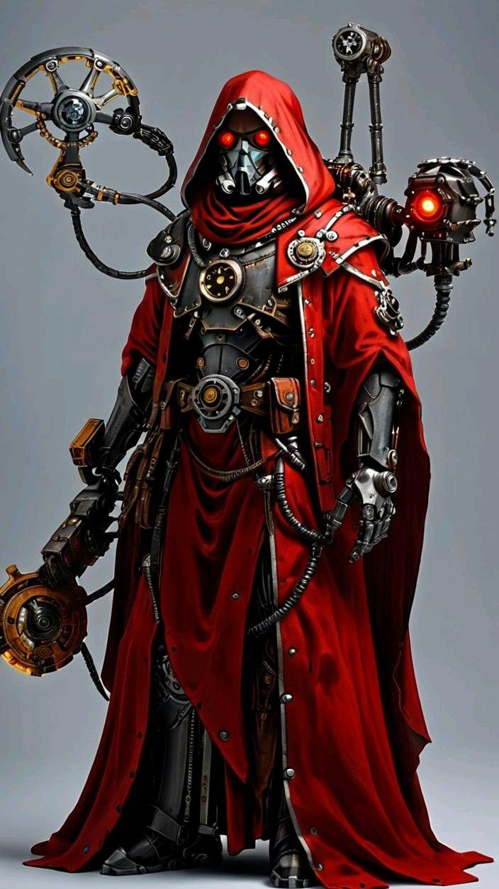
The Formula
Q(s,a)=Q(s,a)+α[r+γmaxQ(s′,a′)−Q(s,a)]
Q(s, a) → The current guess for how good the action (a) in this state (s) is
α → How fast he updates what he knows
r → Reward
γ → How much we value current over future rewards
max Q(s', a') → The best future reward he can expect
This function will return how good is it to be in the state s and take an action a in this state

Slide 19
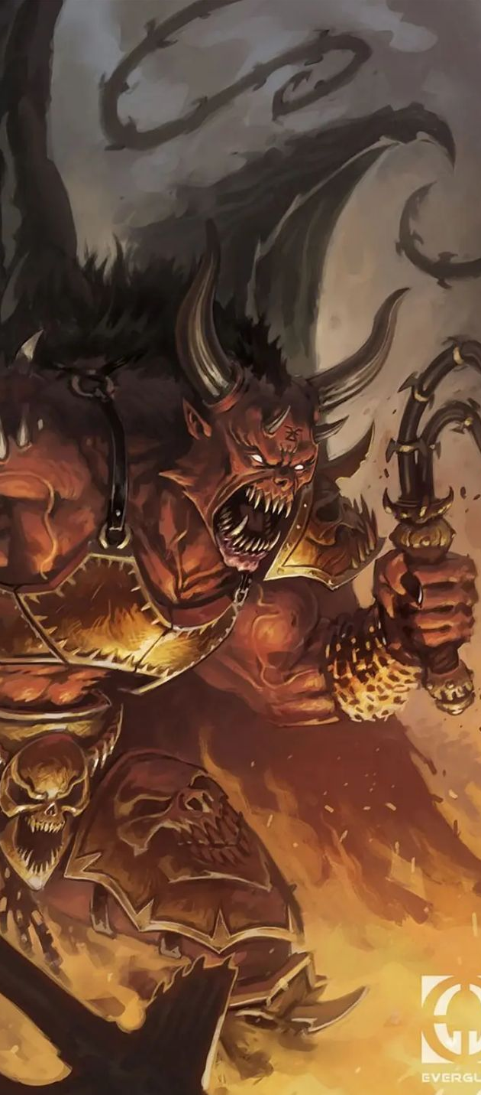
Learning parameters
Learning Rate (α) : How fast Bob adapts?
- Learns too fast → Forms an opinion too quickly
- Learns too slow → Keeps repeating the same mistakes
✅ Smart Bob :
Remembers key lessons but still adapts
Future Discount (γ) : Thinking Long or Short-Term?
- Short-term → Misses big rewards
- Long-term → Waits too long & loses
✅ Smart Bob :
Balances small wins & big rewards
This is a Bloothirster

Slide 20

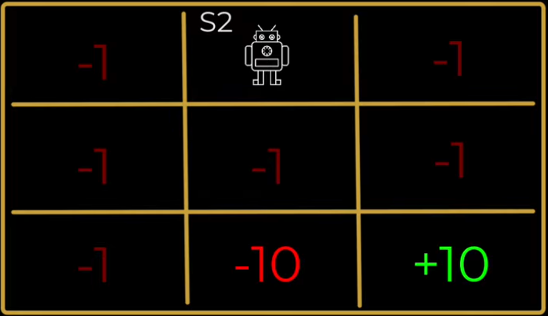
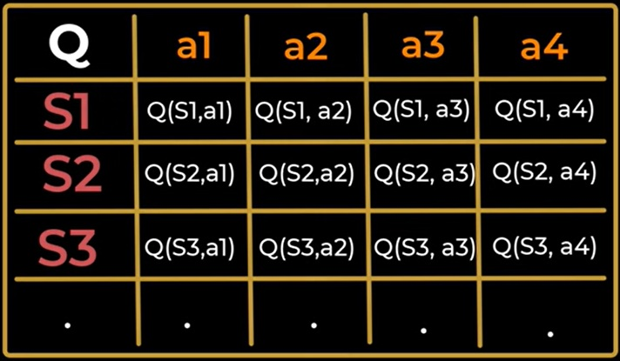
The Q table
Think of the Q-table as Bob’s personal cheat sheet
Goal :
Update and learn these Q-values such as the total reward is maximized
v

Slide 21
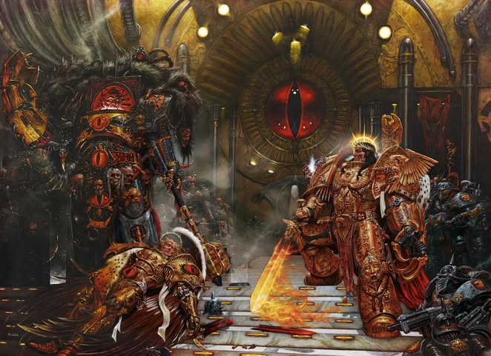
Apply it to Warhammer 40k

Slide 22
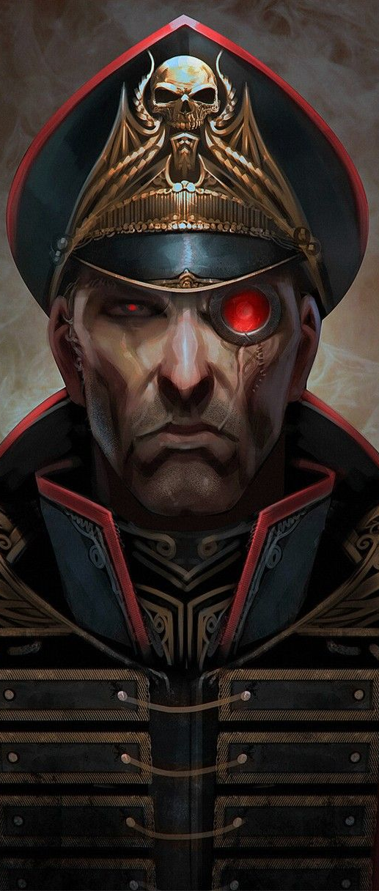
Observation
How Bob knows his environment ?
DQN Input
142 positions array :
- General game status (Active player, turn, etc...)
- Informations about all the units on the board
- Situation on the board
- Board structure

Slide 23
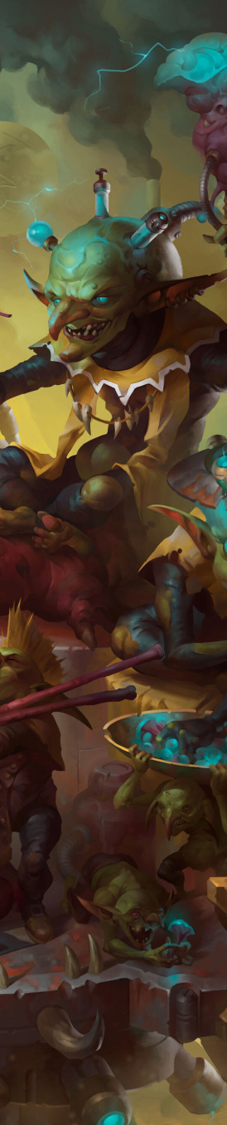
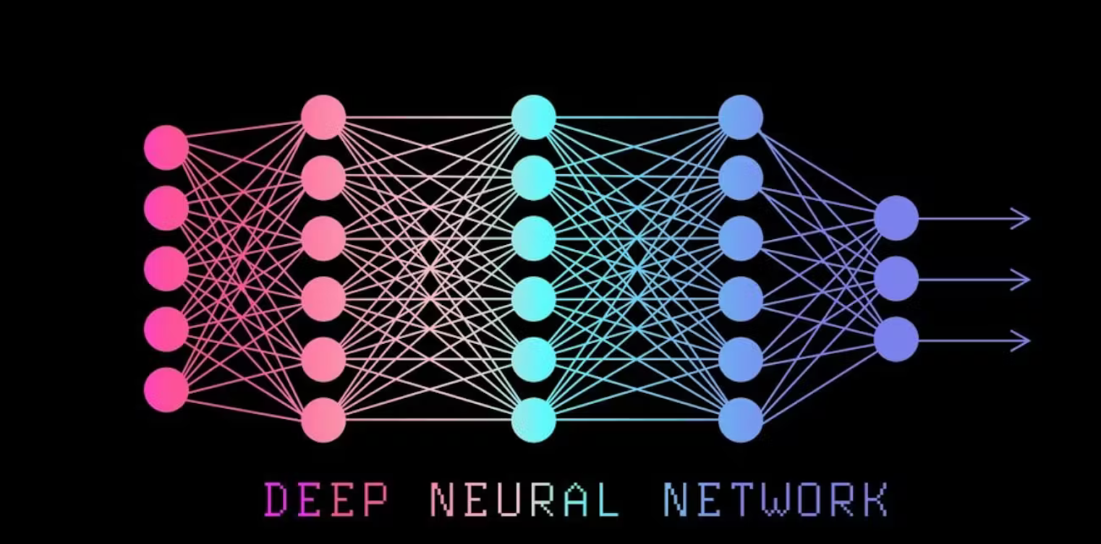
From Q-table to DQN
(Enter Bob's brain)
How does Bob handles his environment ?
v
Observation
Hidden Layers
Actions
142
8

Slide 24
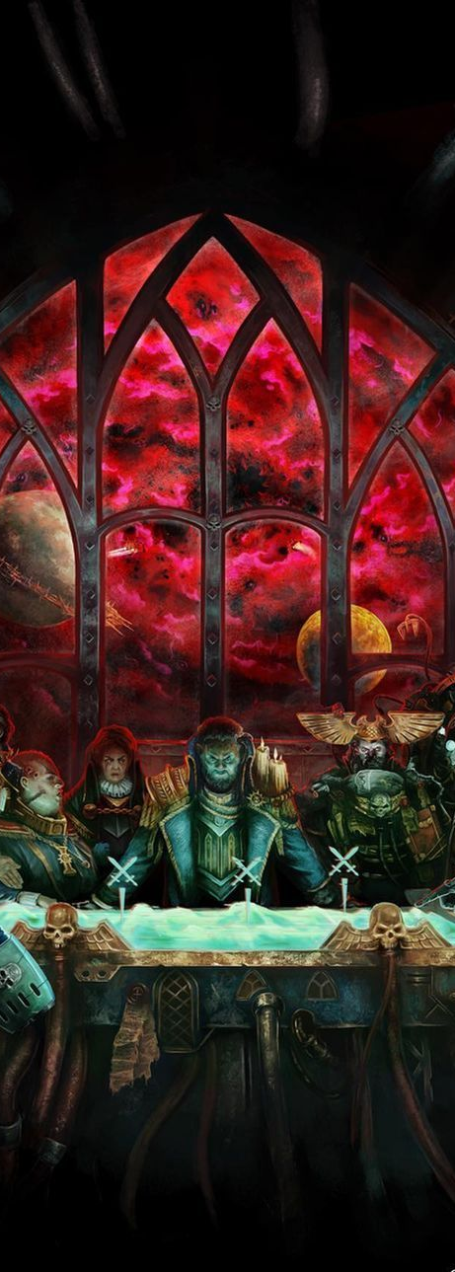
Tailor Strategy
How Bob learns to play ?
Exploration
What if I go left ?
Estimation
I should get +2 Reward
Adjustment
Reality check
Bob get +2 for moving left...
But also -5 for being shot !

Slide 25
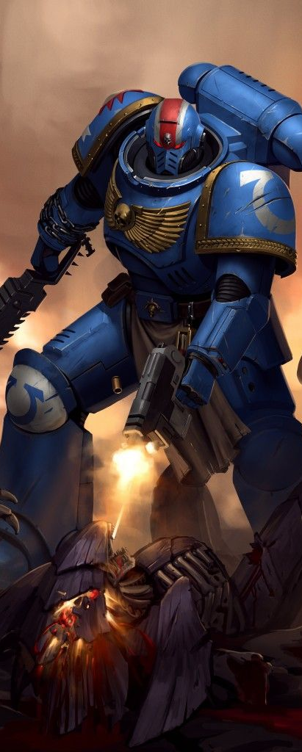
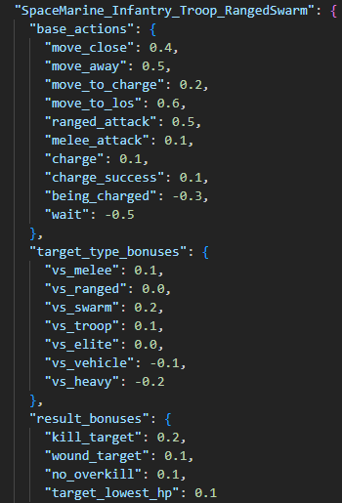
Rewards
How Bob knows if he is doing good ?

Slide 26
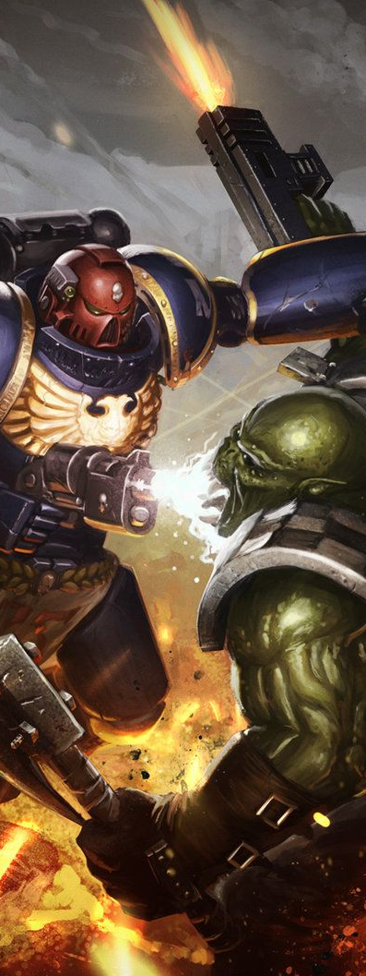
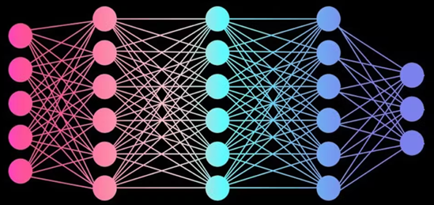
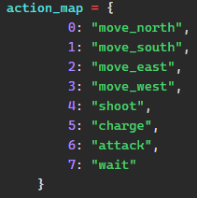
Make a Choice
What will Bob decide to do ?
Action taken : Action with the highest Q-value

Slide 27
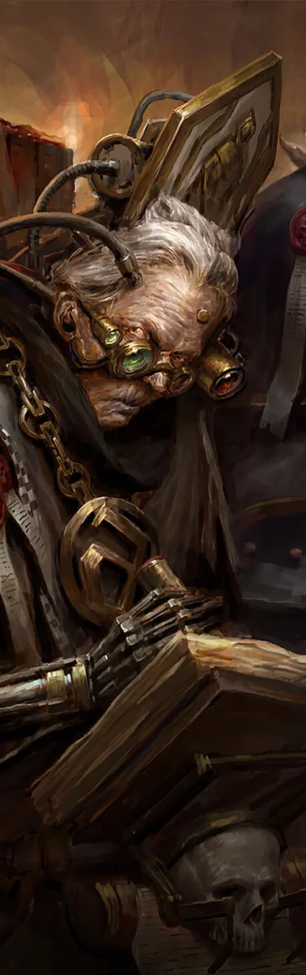
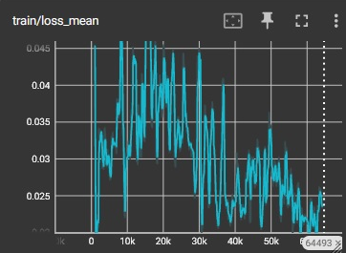
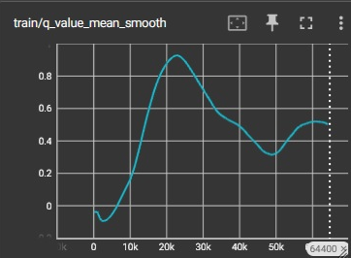
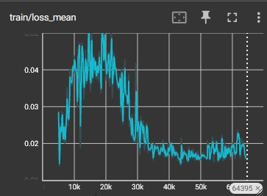
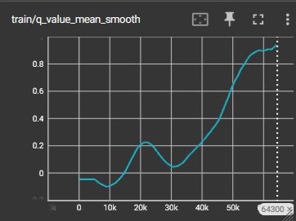
Supervision
How to ensure Bob is well trained ?
Loss
Q-Value

Slide 28
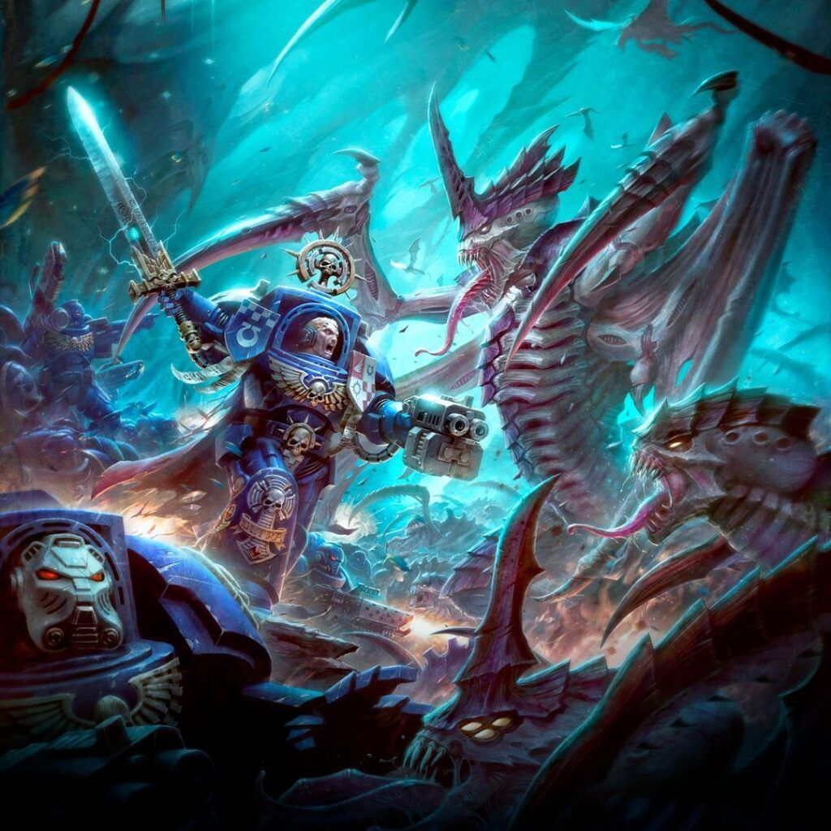
Let's Playyyy !!!

Slide 29
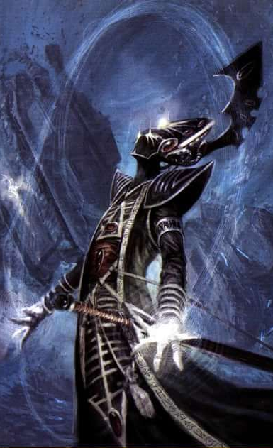
Future improvements
1 - Finish the game's core
- Add the charge and combat phases
2 – Upgrade Observation
- Add tactical datas
3 – Optimize the agent training
- Make it worth playing against
4 - Add new units
- Assault Intercessors, Captain Gravis....
5 - Add new factions
- Tyranids, Orks, etc...
6 - Share the game !

Slide 30
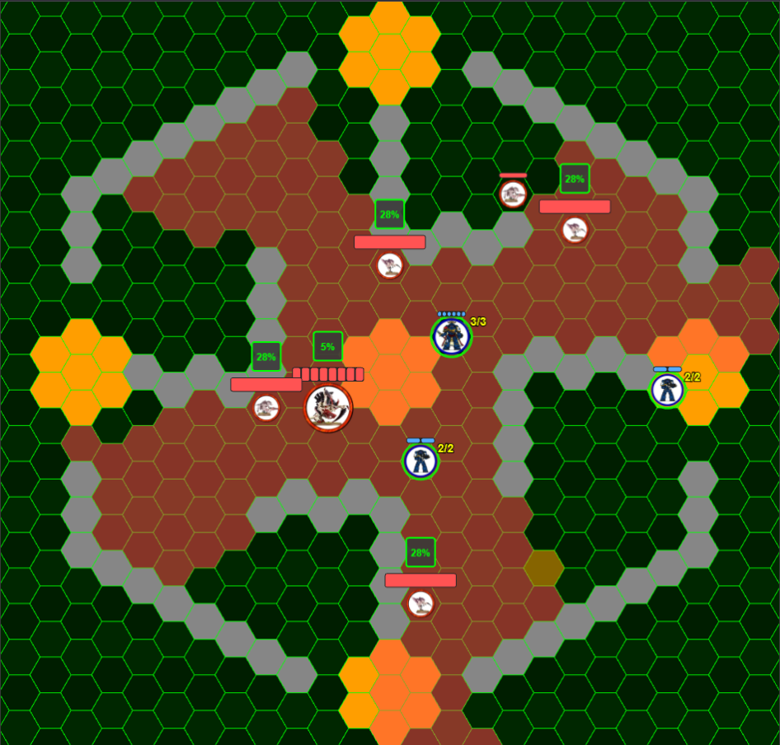
Future Features
Complete the turn
- Add the last phases
Tactical Objectives
New Marins Unit
Captain Gravis
New Faction Tyranids
Tyranids Unit
Carnifex
Hormagaunt
Termagant

Slide 31
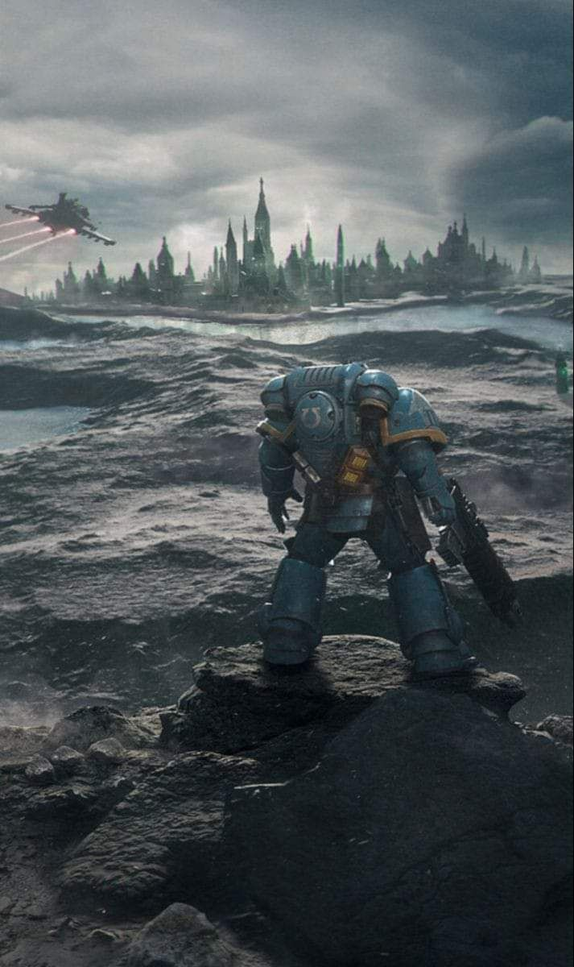
My Future
Find a first job in AI
…
Anywhere in the galaxy !
(and keep learning)

